Slide 1
JAVA MICROSERVICES
RLL - Group 7

Slide 2


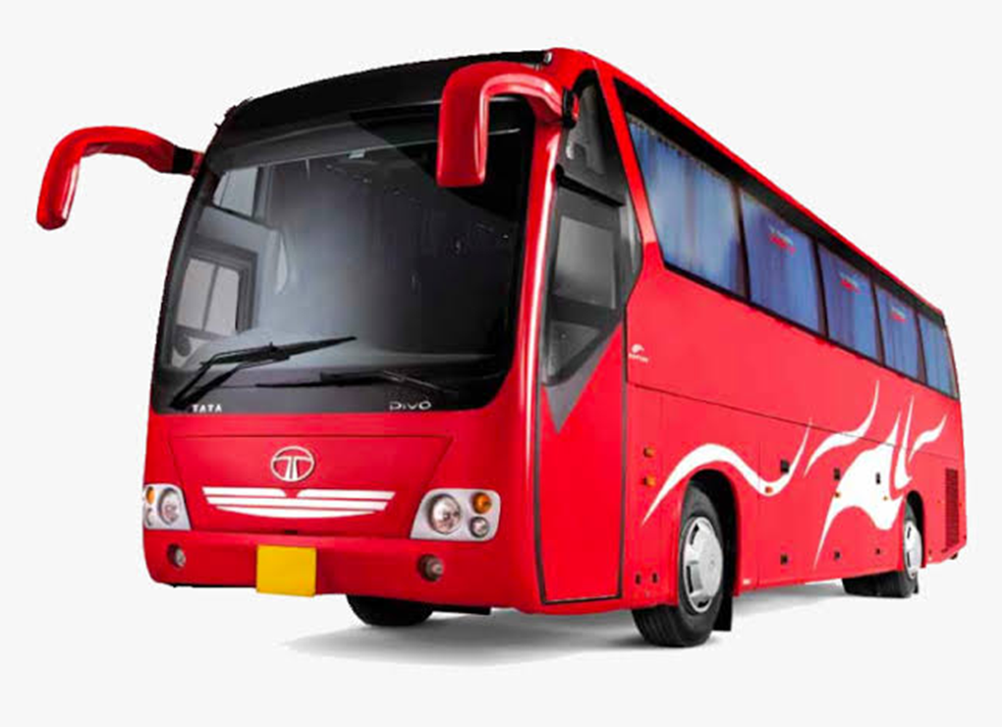
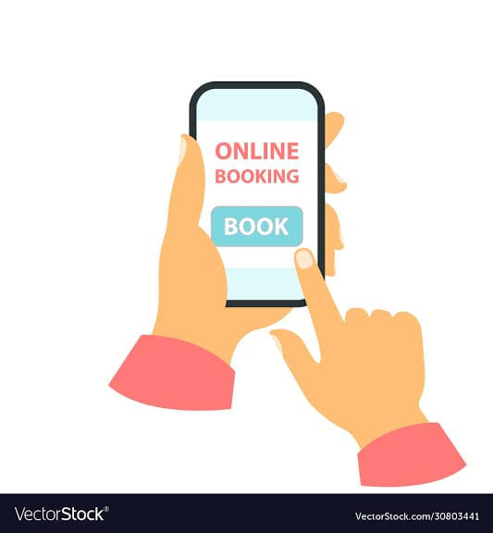
ONLINE BUS BOOKING SYSTEM

Slide 3
230 Java SL AB - Java Microservices
RLL - Group 7
EMPLOYEE NAME | EMPLOYEE ID
HARSH SHARMA | 2564318
SAIYOGESH H | 2564341
SANCHAI VALAN RAJ V | 2563381
VINAYAKA SANJANA | 2563930
SHASHI SHEKHAR | 2563105
DEEPAK X | 2563490
D SAKTHIVEL | 2563069
SREE SANTHOSHINE K | 2563937
KRISHNANSHU X | 2562951

Slide 4
INTRODUCTION
The Online Bus Booking System is a system that manages the bus company booking or ticketing processes
To develop required backend RESTful Web services based on the UI using Java Microservice and Spring Cloud Architecture.
The end goal of the project is to create “Online Bus Booking System” with a rich and user-friendly interface.

Slide 5
OBJECTIVE
To Develop a Backend Restful Web services for Online Bus Booking System for managing the bus company booking or ticketing processes based on the UI designed by front-end team using Java Microservice architecture.

Slide 6
TOOLS AND TECHNOLOGIES
Server-side: Spring Boot, Spring Cloud, Spring Data JPA
Database: MySQL
Server: Embedded Tomcat
DevOps: Docker, Git Hub
Spring Cloud: Spring Cloud Config, Spring Cloud Netflix Eureka, Feign, Resilience4j, Retry, Sleuth and Zipkin

Slide 7
SCOPE
The scope of our project are as follows:
A person should be able to
Login to the system with ID and Password
Book the bus ticket
Make payment

Slide 8
MODULES
User Module : User Module has
Profile
Bookings
Sign out
Admin Module : Our Admin Module has important functionalities like
Bookings
Add Bus
View Buses
Update Route
Sign out

Slide 9
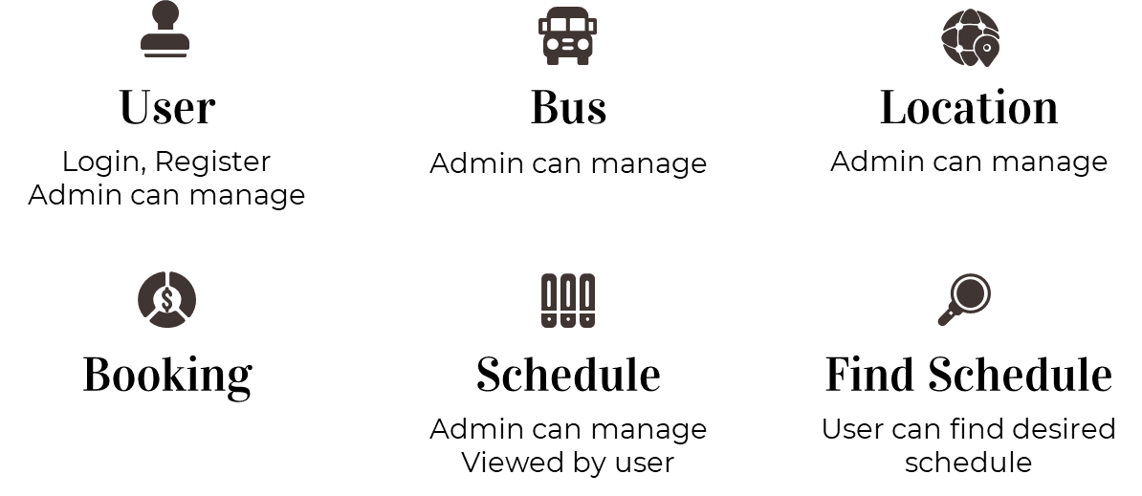

Slide 10
SPRING BOOT
Spring Boot is an open source Java Based framework used to create a microservice.
It helps to create Stand alone and production ready Spring applications.
Spring Boot contains comprehensive infrastructure support for developing a microservice and enables you to develop enterprise ready applications.

Slide 11
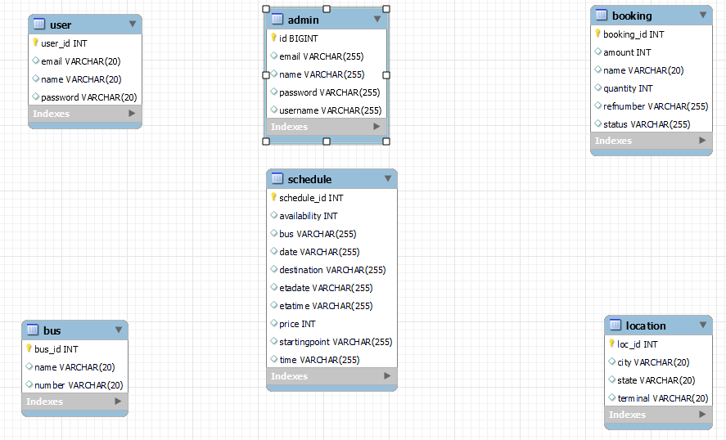
ER DIAGRAM

Slide 12
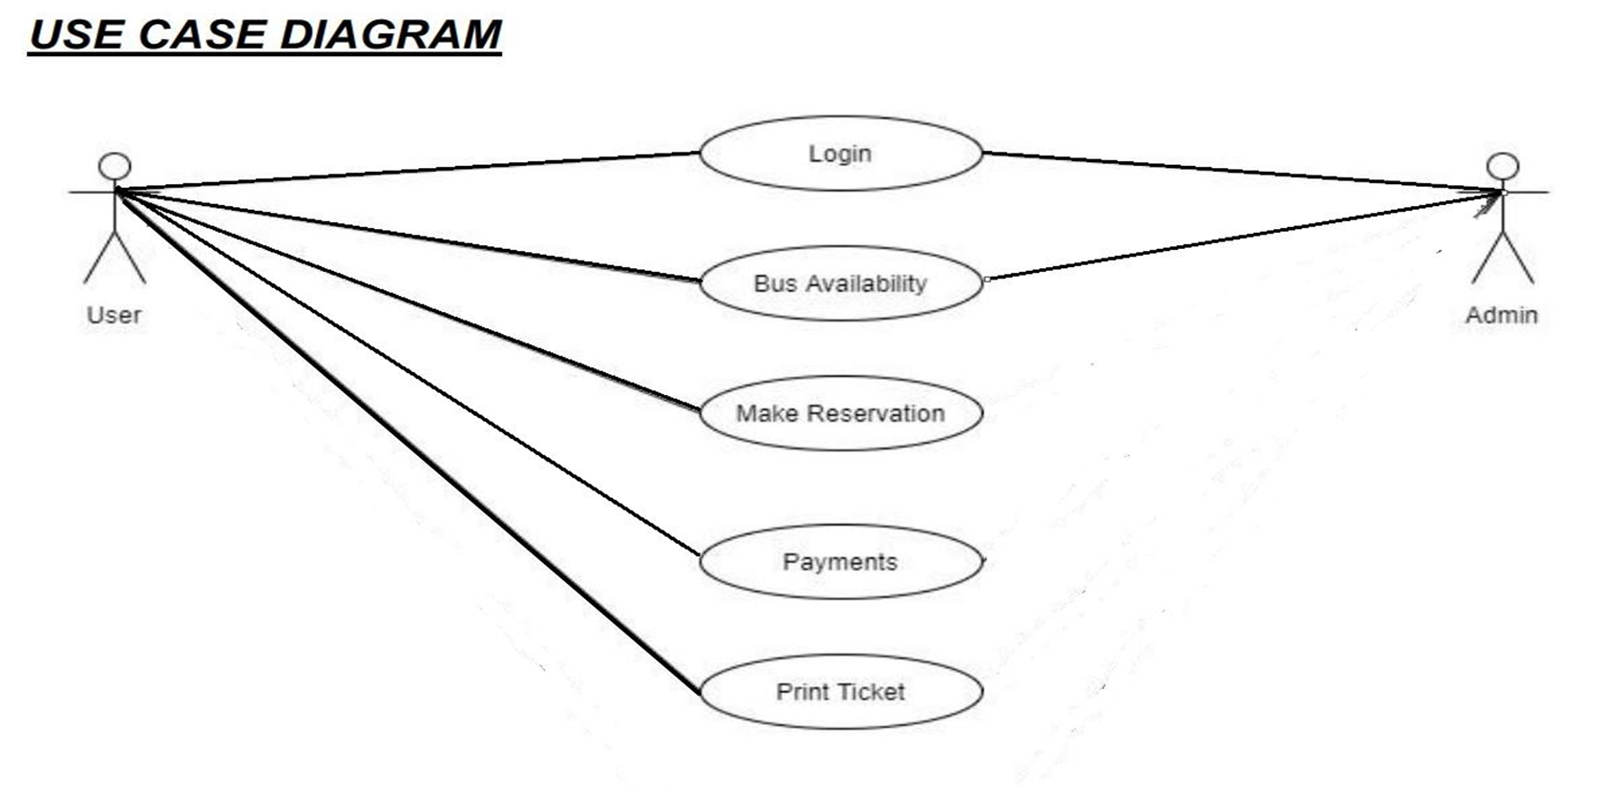
USE CASE DIAGRAM

Slide 13
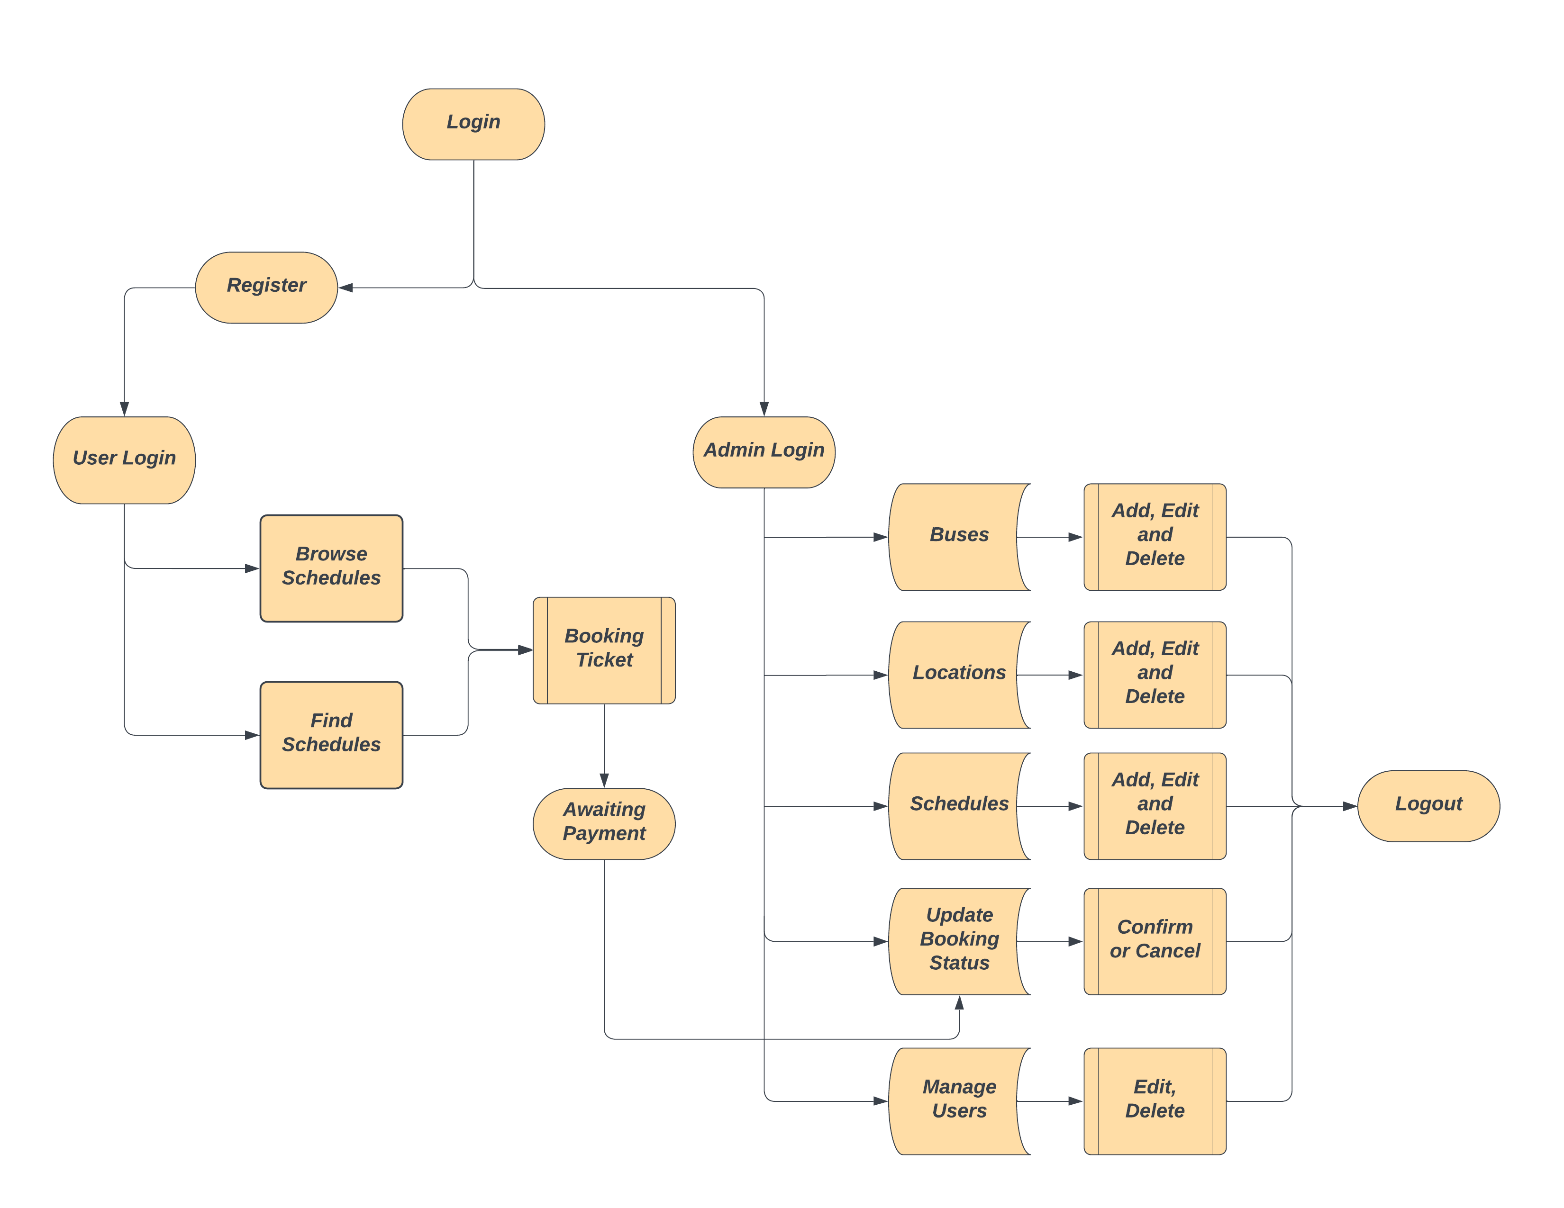
PROCESS

Slide 14
ADMIN.JAVA
This class is typically used for managing and storing admin-related data in a database within a Java application.
This class provides a blueprint for creating Admin objects with various attributes. The use of Lombok annotations helps reduce the amount of boilerplate code you'd normally need to write.
This class seems to represent an entity for an admin user in an online bus booking system.
ADMIN CONTROLLER
This controller manages various admin-related operations by handling incoming HTTP requests and interacting with a service (likely through AdminServiceProxy) to perform the necessary actions. It also logs relevant information for each request and response.

Slide 15
ADMIN REPOSITORY
This interface provides a contract for interacting with a data source (likely a database) for Admin entities. It extends JpaRepository, which provides a set of generic methods for performing common operations on entities, like save, delete, find by ID, etc.
Admin.java in the online bus booking system, Config server likely contains code for managing administrative functions, such as user permissions, database configurations, and system settings, crucial for the system's operation and security.
ADMIN.JAVA-CONFIG SERVER
ADMIN.JAVA-EUREKA SERVER
Admin.java in the online bus booking system, Eureka server is responsible for handling administrative tasks related to service discovery and registration, allowing system administrators to monitor and manage registered microservices efficiently.

Slide 16
ADMIN.JAVA-FEIGN-RESILIENCE4J SERVER
In the online bus booking system's Feign and Resilience4j server, Admin.java likely provides a means to configure and manage resilience-related settings for microservices communication, ensuring reliable and fault-tolerant interactions between services in the system.
It may also handle Feign client configurations and customizations for efficient API communication.
ADMIN.JAVA-RETRY SERVER
The `Admin.java` file in the online bus booking system Retry Server likely contains code responsible for managing administrative functions and privileges within the system.
It may include features such as user management, system configuration, and access control to ensure smooth operation and security of the booking platform.

Slide 17
ADMIN.JAVA-SLEUTH SERVER
In the online bus booking system Sleuth Server, the `Admin.java` file is likely responsible for handling administrative tasks, such as user management and system configuration, to maintain the platform's functionality and security.
ADMIN.JAVA-ZIPKIN SERVER
In the online bus booking system Zipkin Server,
The `Admin.java` file may play a role in managing administrative functions, such as user access and system settings, to ensure efficient operation and security of the system while facilitating tracing and monitoring capabilities provided by Zipkin.

Slide 18
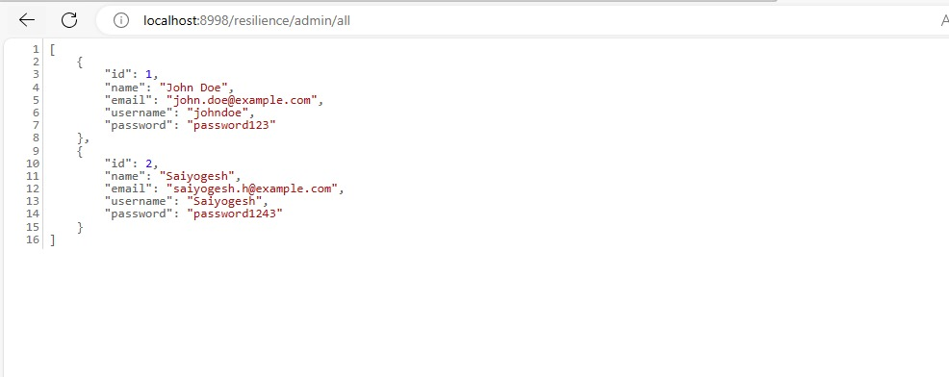

Slide 19
USER.JAVA
User, represents a database entity for storing user information.
It includes attributes like id, name, email, and password.
It includes attributes to store user information, constructors for object creation, and methods to access and modify user data.
USER CONTROLLER
This controller manages various user-related operations by handling incoming HTTP requests and interacting with a service (likely through UserServiceProxy) to perform the necessary actions. It also logs relevant information for each request and response.

Slide 20
USER REPOSITORY
This Java interface named UserRepository is part of a Spring application and extends JpaRepository<User, Integer>. It's likely used for interacting with a database or a data source related to user entities.
The custom methods findByEmailAndPassword and findByEmail are query methods specific to the User entity. They will be automatically implemented by Spring Data JPA based on the method name.
USER.JAVA CONFIG SERVER
User.java in the online bus booking system config server likely represents user-related configurations or permissions, enabling system administrators to manage access rights, roles, and settings for various users interacting with the configuration server, ensuring controlled and secure system administration.

Slide 21
USER.JAVA EUREKA SERVER
User.java in the online bus booking system, as Eureka primarily deals with service registration and discovery, which doesn't typically involve user-related functionalities.
It might handle user-specific configurations or permissions for administrative access to the Eureka server.
USER.JAVA FEIGN-RESILIENCE SERVER
In the online bus booking system's Feign and Resilience server,
User.java is likely unrelated to these libraries' core functionalities, as they primarily focus on microservices communication and resilience patterns.
It handle user-specific data or credentials for secure API interactions between microservices

Slide 22
USER.JAVA RETRY SERVER
In online bus booking system with a Retry server,
"User.java" is likely a Java class responsible for handling user-related operations, such as creating, modifying, or retrieving user profiles and authentication.
It may also incorporate retry mechanisms to ensure robust user interactions in case of failures during booking or user-related tasks.
USER.JAVA SLEUTH SERVER
In online bus booking system using a Sleuth server,
"User.java" is likely a Java class responsible for managing user-related functionality.
It may include methods for user registration, login, profile management, and authentication, contributing to the system's user-centric features and security.

Slide 23
USER.JAVA ZIPKIN SERVER
In online bus booking system using a Zipkin server,
"User.java" is probably a Java class responsible for managing user-related actions, like user authentication, registration, and profile management.
It might also incorporate tracing and monitoring features provided by Zipkin for better visibility into user interactions and system performance.

Slide 24
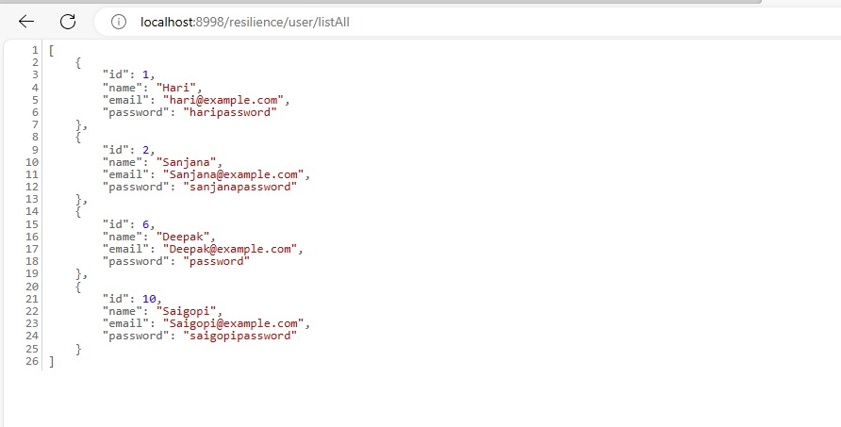

Slide 25
BUS.JAVA
In an online bus booking system, this class serves as an entity definition for a bus in the online bus booking system. It includes attributes to store information about a bus, annotations for database mapping, and constructors/methods for object creation and manipulation. This class is designed to be used in conjunction with a JPA implementation for database interaction.
It utilizes JPA annotations for seamless database integration and data management within the system.
BUS CONTROLLER
BusController is a Spring Boot controller responsible for handling HTTP requests related to bus operations in an online bus booking system. This injects an instance of BusService. This service is likely responsible for business logic related to bus operations.
This controller manages various bus-related operations by handling incoming HTTP requests and interacting with a service (likely through BusService) to perform the necessary actions.

Slide 26
BUS REPOSITORY
This Java interface named BusRepository is part of a Spring application and extends JpaRepository<Bus, Integer>. It's used for interacting with a database or a data source related to bus entities.
The custom methods findByNumber and findByName are query methods specific to the Bus entity. They will be automatically implemented by Spring Data JPA based on the method name.
BUS.JAVA CONFIG SERVER
In an online bus booking system with a configuration server, the Bus.java class defines bus entity properties and relationships, enabling dynamic configuration of bus-related data such as routes, schedules, and fares through the server's centralized configuration management.
The class's JPA annotations facilitate data storage and retrieval, ensuring that configuration changes are efficiently applied across the system.

Slide 27
BUS.JAVA EUREKA SERVER
In an online bus booking system with Eureka Server,
The Bus.java Eureka Server helps with service discovery and registration, allowing other microservices in the system to locate and communicate with the bus service represented by the Bus.java class, enhancing the overall system's scalability and reliability.
BUS.JAVA FEIGN-RESILIENCE SERVER
In an online bus booking system with a Feign-Resilience Server,
The Bus.java class can be part of a microservice that communicates with other services using Feign clients, enhancing system resilience by incorporating circuit breakers and fault tolerance mechanisms to ensure reliable interactions and improve the overall system's availability.

Slide 28
BUS.JAVA RETRY SERVER
The "Bus.java" file in the online bus booking system retry server likely contains the core functionality for managing bus-related data and operations.
It could include methods for adding, updating, and retrieving bus information, as well as handling seat reservations and availability checks within the system.
BUS.JAVA SLEUTH SERVER
In the online bus booking system Sleuth server,
The "Bus.java" file is likely responsible for implementing bus-related functionalities such as creating, modifying, and deleting bus records.
It may also include features for tracking bus routes, schedules, and associated information to facilitate efficient booking processes.

Slide 29
BUS.JAVA ZIPKIN SERVER
In the online bus booking system Zipkin server,
The "Bus.java" file probably handles bus-related data and functionalities.
This may encompass tasks like managing bus schedules, availability, and pricing to enable seamless booking and tracking of buses within the system.

Slide 30
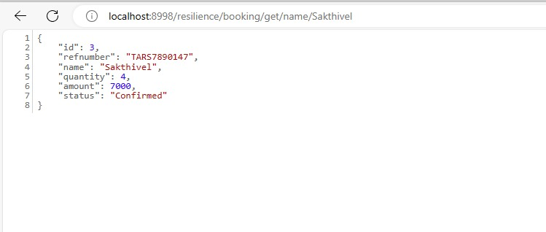

Slide 31
LOCATION.JAVA
Location.java is an entity class that represents a location, possibly a terminal, in an online bus booking system.
This class likely contains methods to to store information about a location, annotations for database mapping, and constructors/methods for object creation and manipulation.
It is designed to be used with the Java Persistence API (JPA), and likely in a Java EE (Enterprise Edition) or Jakarta EE application.
LOCATION CONTROLLER
This controller manages various location-related operations by handling incoming HTTP requests and interacting with a service (likely through LocationService) to perform the necessary actions.

Slide 32
LOCATION REPOSITORY
This interface provides a contract for interacting with a data source (likely a database) for Location entities. It extends JpaRepository, which provides a set of generic methods for performing common operations on entities, like save, delete, find by ID, etc.
The custom method findByTerminal is a query method specific to the Location entity. It will be automatically implemented by Spring Data JPA based on the method name. This method allows finding a Location by its terminal name..
LOCATION.JAVA CONFIG SERVER
Location.java in an online bus booking system configuration server typically refers to a component of a microservices architecture that is responsible for storing and serving configuration properties to applications. It allows you to manage application configurations centrally, externalizing them from the codebase.

Slide 33
LOCATION.JAVA RETRY SERVER
Location.java in an online bus booking system, the Retry Server typically refers to a component that is responsible for handling retries in case of failures when making HTTP requests between services. It's a part of the resiliency strategy to ensure robust communication between services.
LOCATION.JAVA SLEUTH SERVER
Location.java in an online bus booking system, the Sleuth Server is part of a distributed tracing system that helps monitor and troubleshoot requests as they propagate through various services. It provides insights into how requests flow through different components, helping to identify performance bottlenecks and troubleshoot errors.

Slide 34
LOCATION.JAVA ZIPKIN SERVER
In the context of the Location.java class ,the Zipkin Server is a distributed tracing system that helps monitor and troubleshoot microservices-based applications.
Zipkin complements Sleuth by providing a powerful tool for visualizing and analyzing the flow of requests in a distributed system. It helps in debugging, monitoring, and optimizing the performance of microservices-based applications.

Slide 35
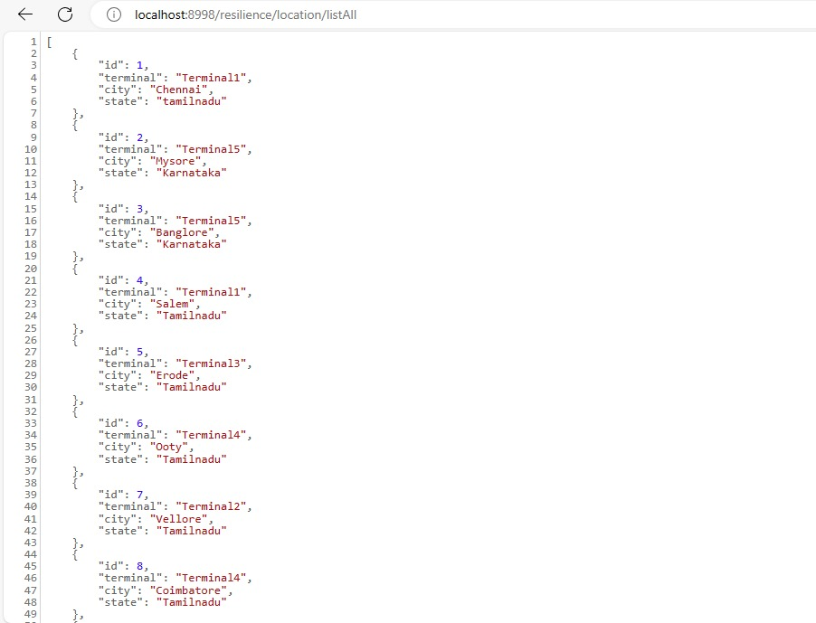

Slide 36
SCHEDULE.JAVA
Schedule.java in an online bus booking system, This class essentially encapsulates the information related to a bus schedule.
This class is used to represent and manage the details of bus schedules within your application.
SCHEDULE CONTROLLER
This controller essentially provides an API for managing schedules in your application. It interacts with the ScheduleService to perform operations like registration, retrieval, update, and deletion of schedules.
The ScheduleController manages the endpoints related to schedules in your application.

Slide 37
SCHEDULE REPOSITORY
The ScheduleRepository is an interface that extends the JpaRepository provided by Spring Data JPA.
This repository is responsible for handling database operations related to the Schedule entity..
SCHEDULE.JAVA CONFIG SERVER
Schedule.java in an online bus booking system , a Config Server allows you to manage configurations for your microservices in a flexible and organized way.
It promotes the principles of externalized configuration and allows for easy management of configuration properties across multiple services.

Slide 38
SCHEDULE.JAVA EUREKA SERVER
In the context of Schedule.java and the Eureka server, it's important to understand that Eureka is a service registry and discovery tool provided by Spring Cloud. It allows services to register themselves and discover other services in a microservices architecture.
It enables services to dynamically find and communicate with each other, promoting flexibility and scalability in your application.
SCHEDULE.JAVA FEIGN-RESILIENCE SERVER
Schedule.java in an online bus booking system , a Feign Resilience Server can make remote calls to other services with added fault tolerance. Hystrix helps prevent failures in one service from affecting the entire application. It provides circuit breaking, fallback mechanisms, and monitoring capabilities to improve the robustness of your microservices architecture.

Slide 39
SCHEDULE.JAVA RETRY SERVER
Schedule.java in an online bus booking system , a Retry Server may configure the retry mechanism to define policies, such as the maximum number of retries, delay between retries, and conditions under which a retry should be attempted.
For example, you might want to retry a failed HTTP request to another service up to three times, waiting for a few seconds between each retry.
SCHEDULE.JAVA SLEUTH SERVER
Schedule.java in an online bus booking system , a Sleuth Server helps you gain insights into the flow of requests in a distributed system. It's particularly valuable in microservices architectures where requests may traverse multiple services. Sleuth allows you to understand the interactions between services, identify performance issues, and troubleshoot problems more effectively.

Slide 40
SCHEDULE.JAVA ZIPKIN SERVER
Schedule.java in an online bus booking system ,the Zipkin server acts as a centralized repository for trace data generated by microservices. It provides tools for querying, visualizing, and analyzing this data, enabling teams to gain insights into how requests flow through their
distributed system. This is particularly useful for debugging, performance optimization, and understanding the interactions between services.

Slide 41
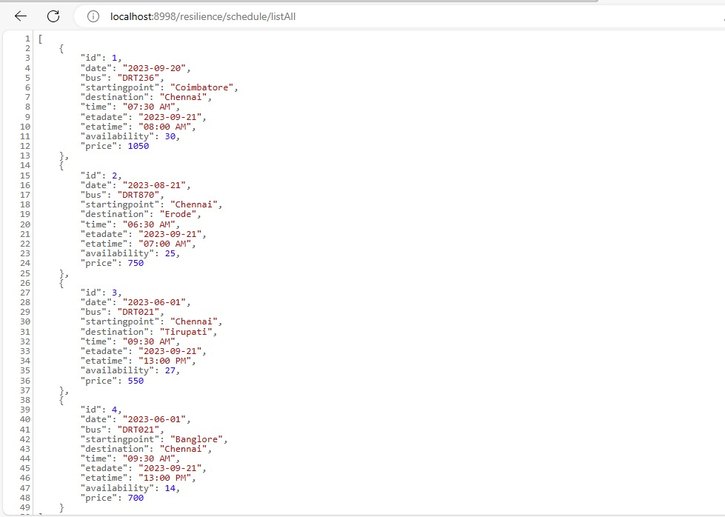

Slide 42
BOOKING.JAVA
This Booking entity can be used to represent and manage booking information within a database.
It's designed to interact with a database using JPA (Java Persistence API), and can be part of a larger system for handling online bus reservations.
BOOKING CONTROLLER
The BookingController acts as an interface between the client and the BookingService.
It processes HTTP requests, delegates the business logic to the service layer, and returns appropriate responses. This controller is part of a larger system for managing bookings in an online bus reservation system.

Slide 43
BOOKING REPOSITORY
The BookingRepository simplifies the process of interacting with the database for the Booking entity.
It provides standard methods for common operations and allows you to define custom query methods for more specific operations. This repository is part of a larger system for managing bookings in an online bus reservation system.
BOOKING.JAVA CONFIG SERVER
Booking.java in an online bus booking system configuration server is responsible for configuring and managing settings related to the booking process, such as setting booking time limits, pricing rules, or defining available bus routes, ensuring the system operates efficiently and in alignment with the business requirements.

Slide 44
BOOKING.JAVA EUREKA SERVER
In an online bus booking system using Eureka Server,
Booking.java Eureka Server functionality, Eureka Server helps with service registration and discovery.
Booking.java handle bus ticket booking logic while Eureka Server manages service registration, enabling other components to locate and interact with it easily in a microservices architecture.
BOOKING.JAVA FEIGN-RESILIENCE SERVER
Booking.java in an online bus booking system with a Feign-Resilience Server could use Feign to simplify HTTP requests to other services, enhancing communication efficiency.
Additionally, it may incorporate resilience patterns like circuit breakers and fallback mechanisms provided by Resilience4j to ensure robust and fault-tolerant booking operations.

Slide 45
BOOKING.JAVA RETRY SERVER
The`Booking.java` in the online bus booking system retry server is a crucial component responsible for handling ticket reservations.
It likely contains code for user interaction, seat selection, and payment processing, ensuring a seamless booking experience for users while handling retries gracefully in case of server errors.
BOOKING.JAVA SLEUTH SERVER
In online bus booking system with Sleuth server,
`Booking.java` is a key module that facilitates ticket booking and tracking.
It is likely designed to incorporate distributed tracing and monitoring capabilities provided by Sleuth to ensure efficient ticket booking and system performance monitoring.

Slide 46
BOOKING.JAVA ZIPKIN SERVER
In online bus booking system integrated with Zipkin server,
`Booking.java` is a critical component responsible for managing ticket reservations and transactions.
It's likely equipped with distributed tracing instrumentation, allowing Zipkin to capture and analyze transactional data for performance optimization and troubleshooting purposes.

Slide 47
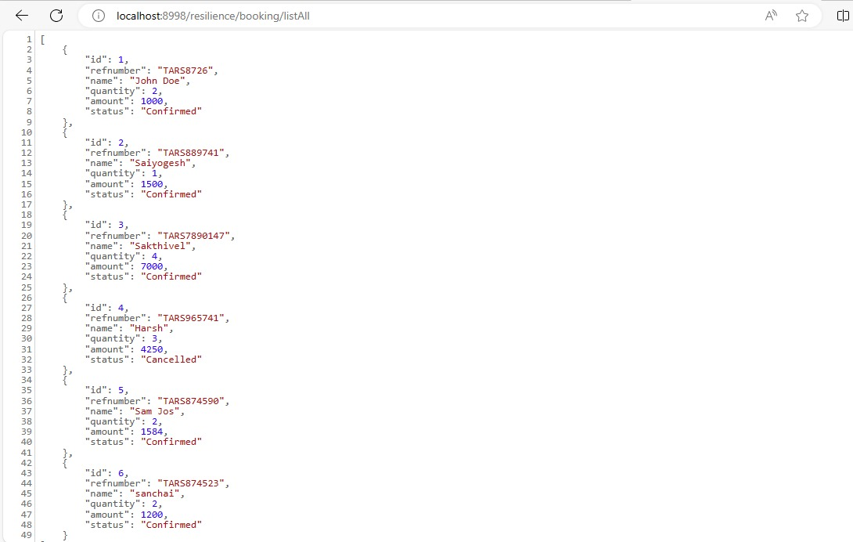

Slide 48
POSTMAN

Slide 49
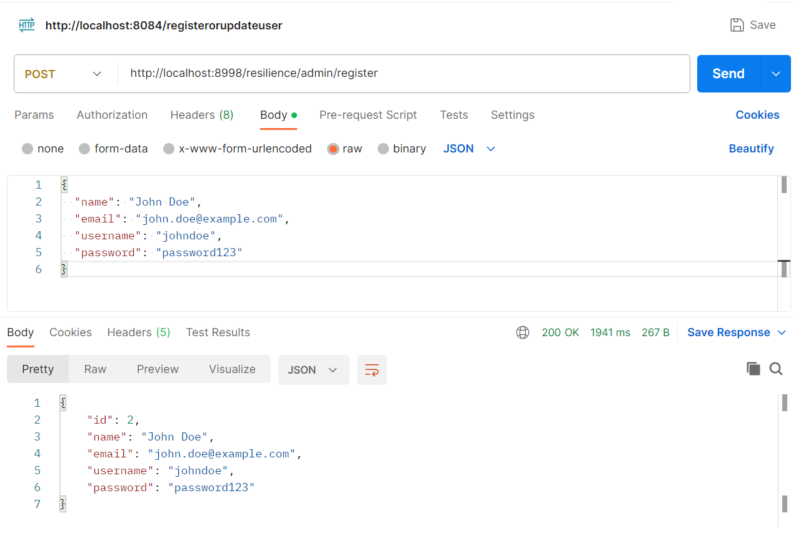

Slide 50
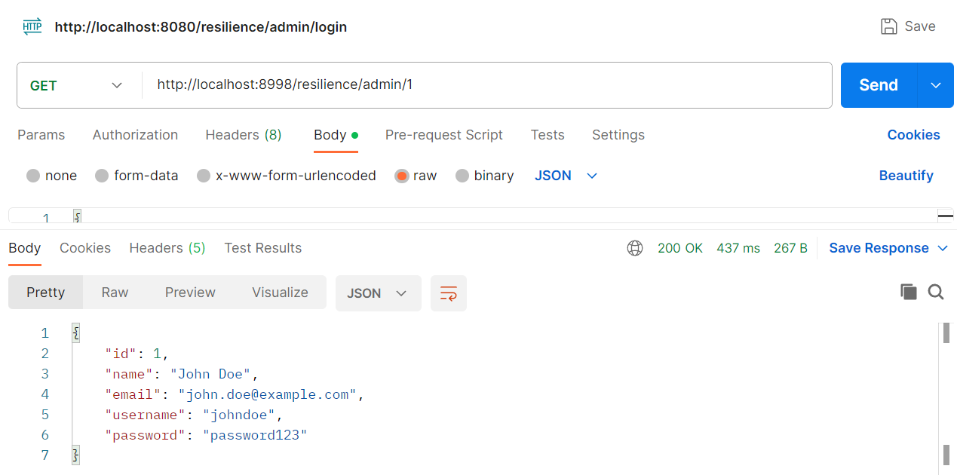

Slide 51
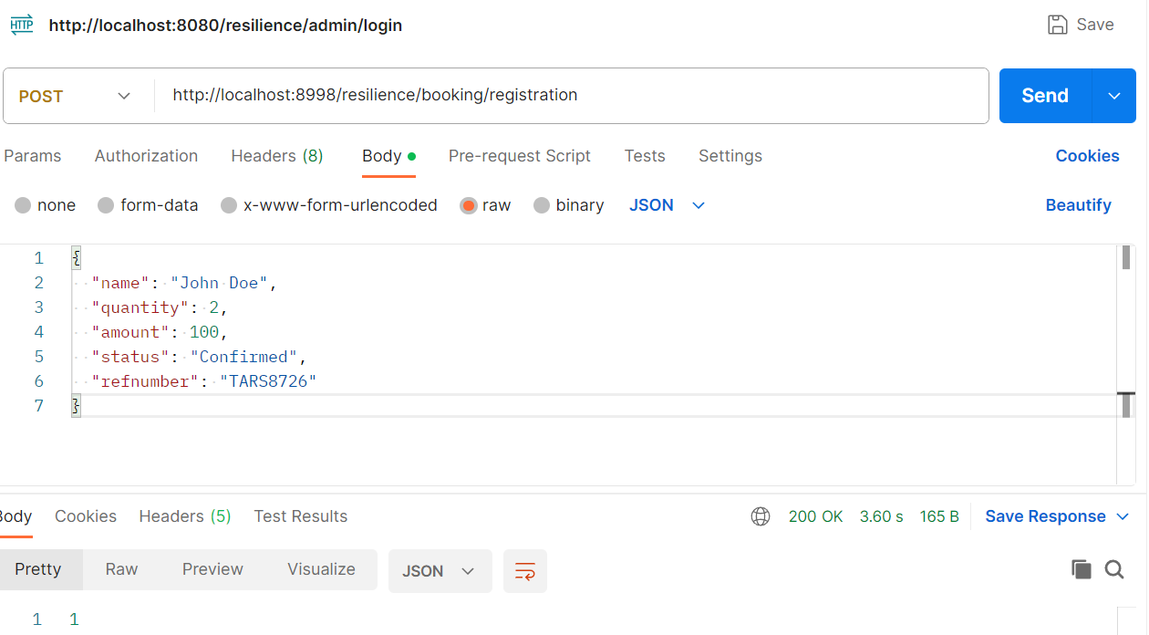

Slide 52
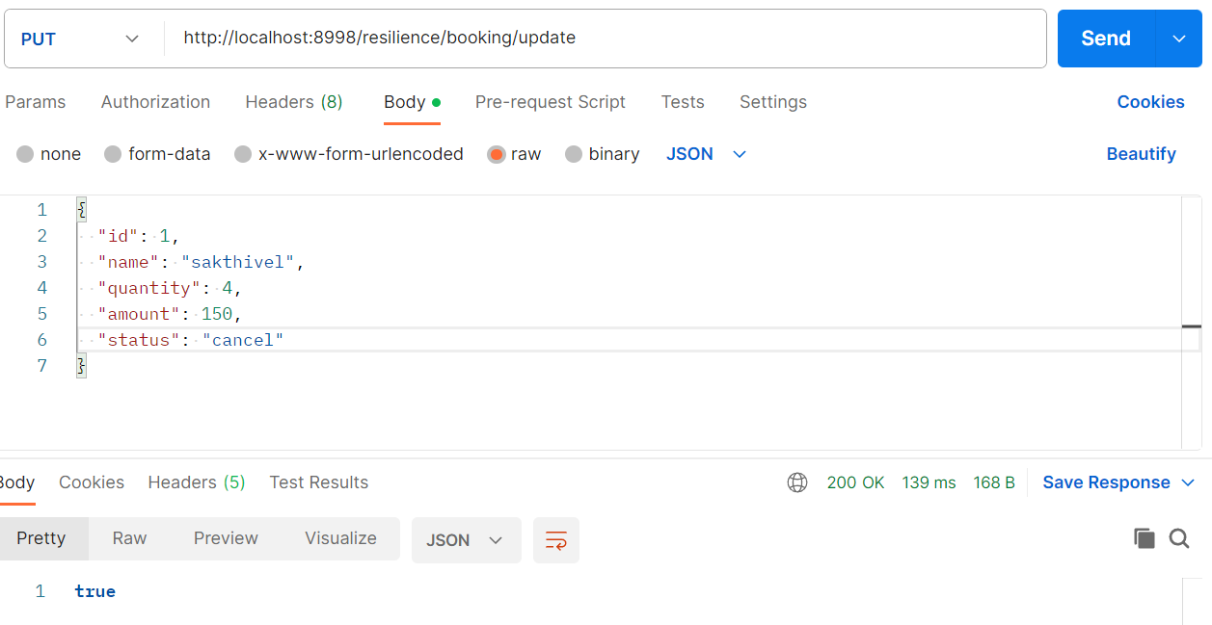

Slide 53
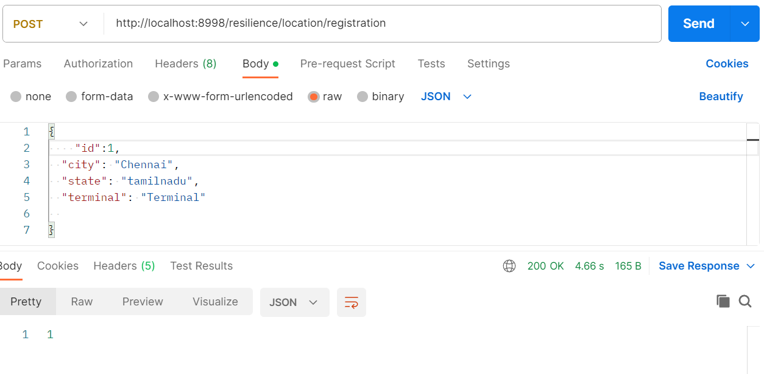

Slide 54
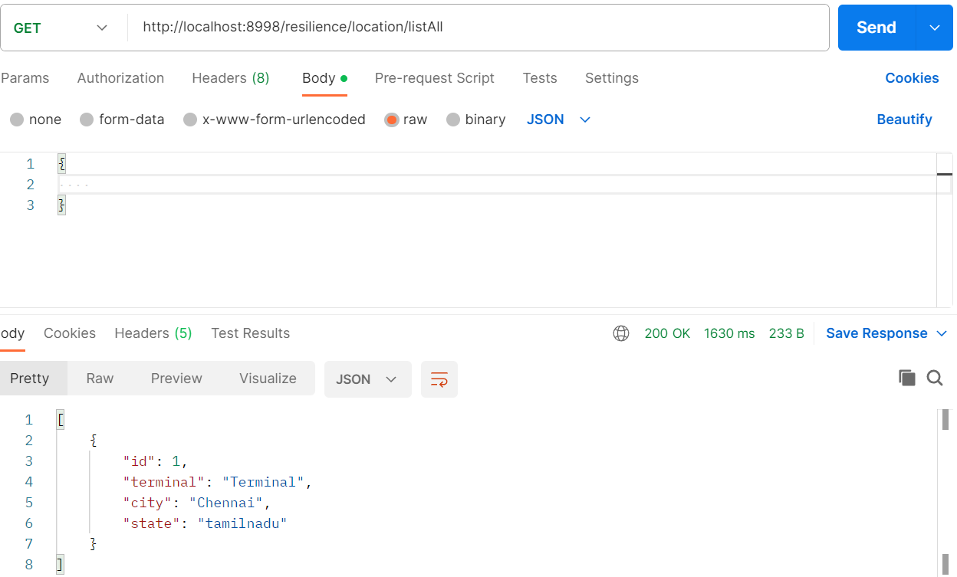

Slide 55
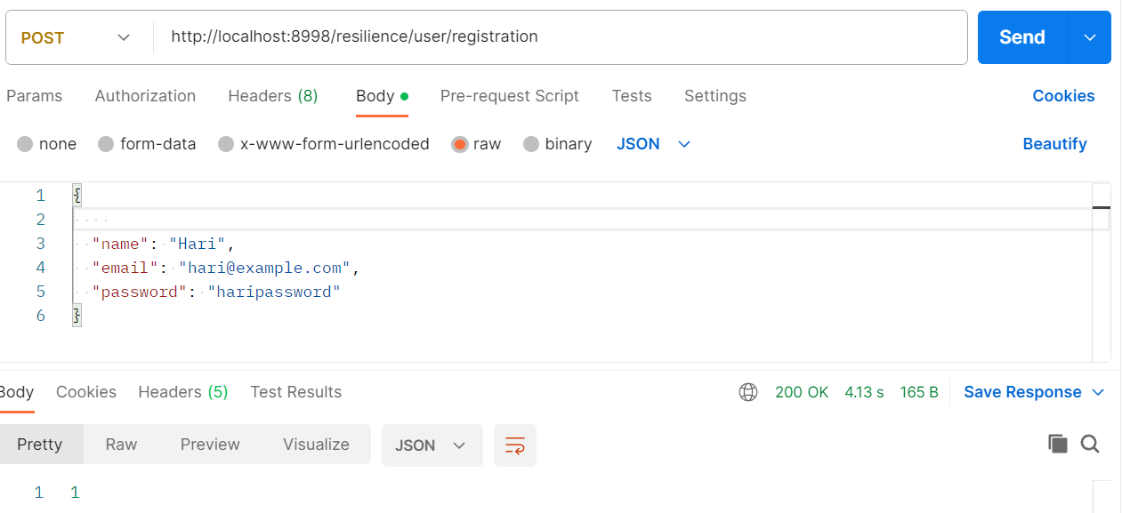

Slide 56
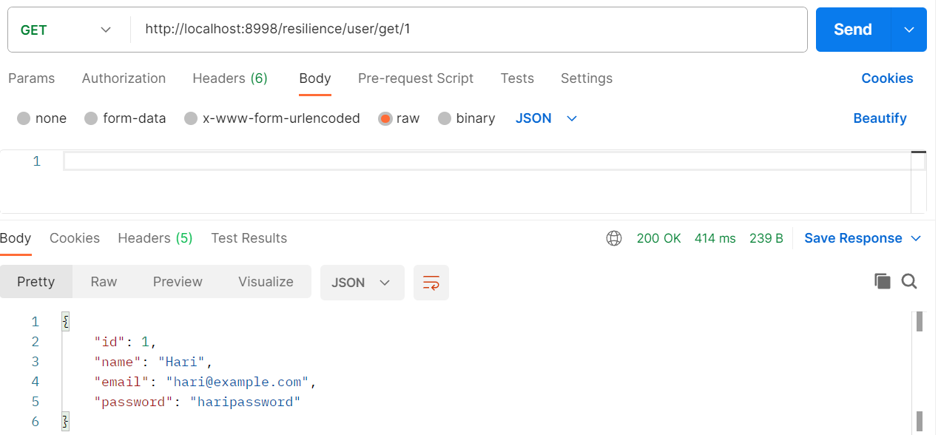

Slide 57
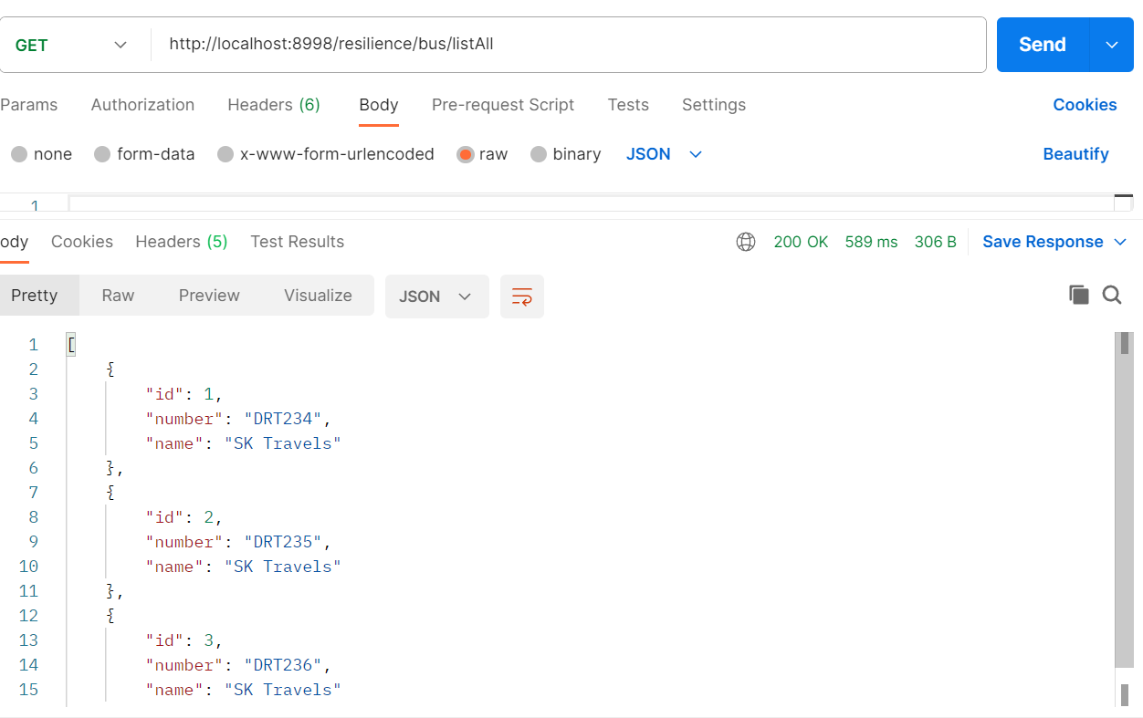

Slide 58
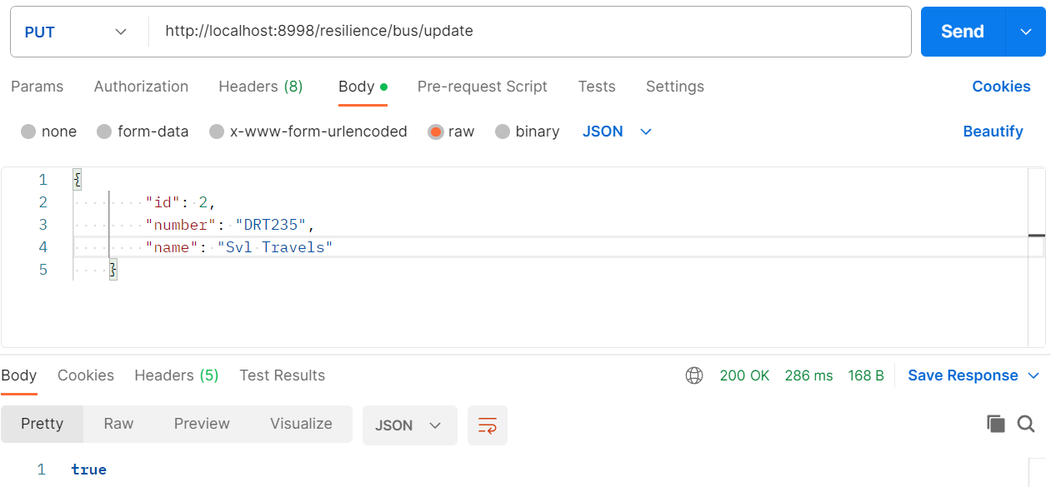

Slide 59
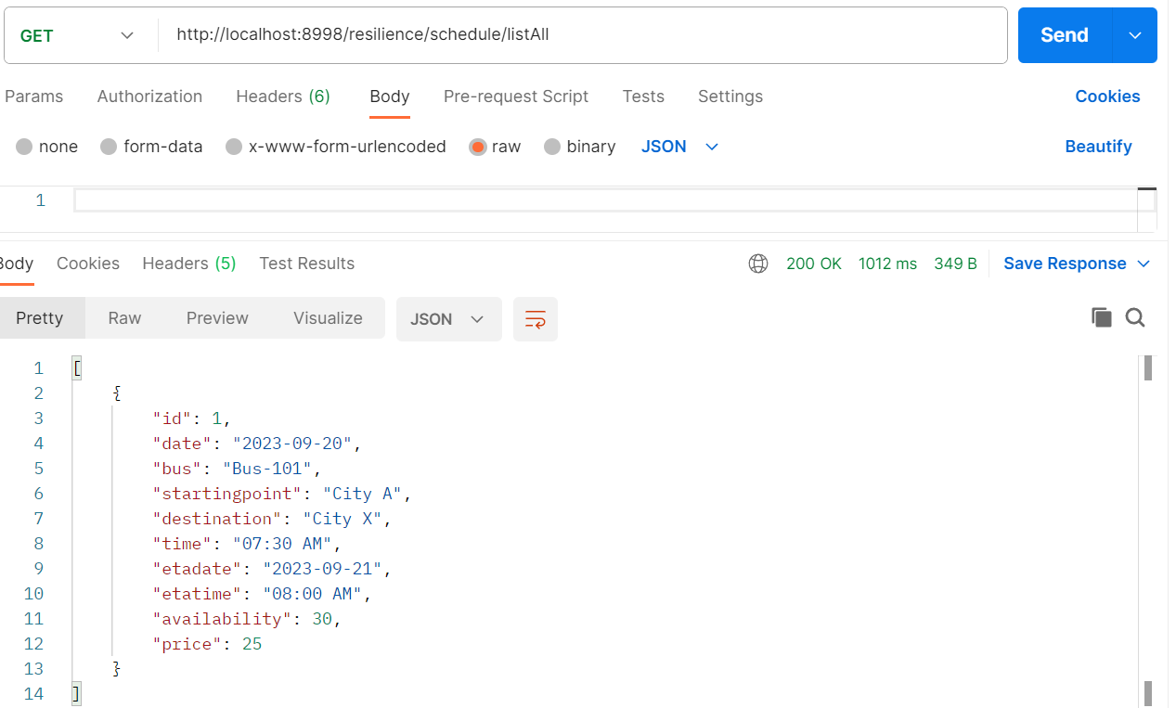

Slide 60
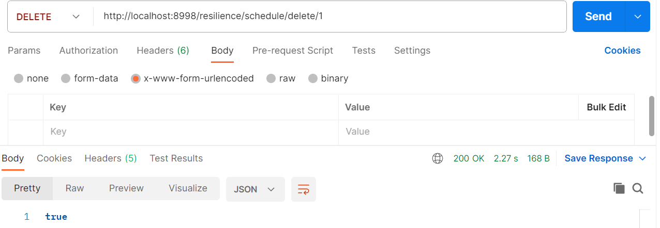

Slide 61
ZIPKINN

Slide 62
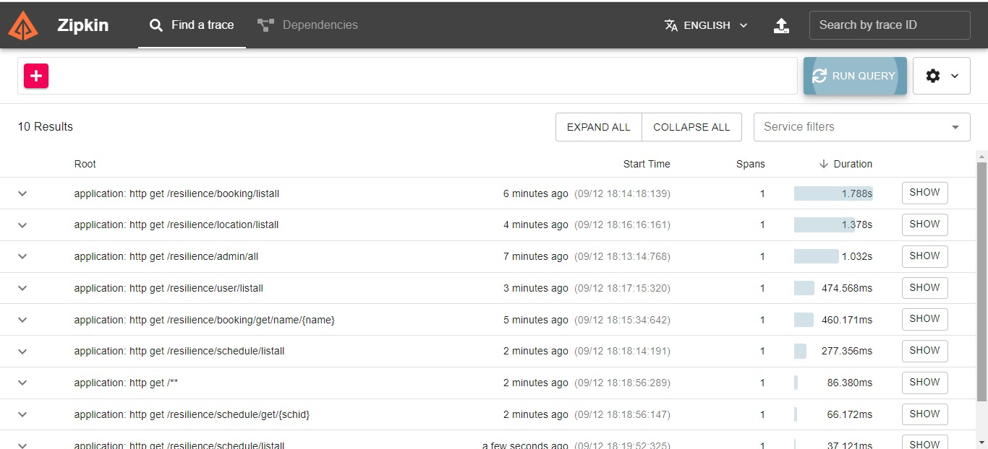

Slide 63
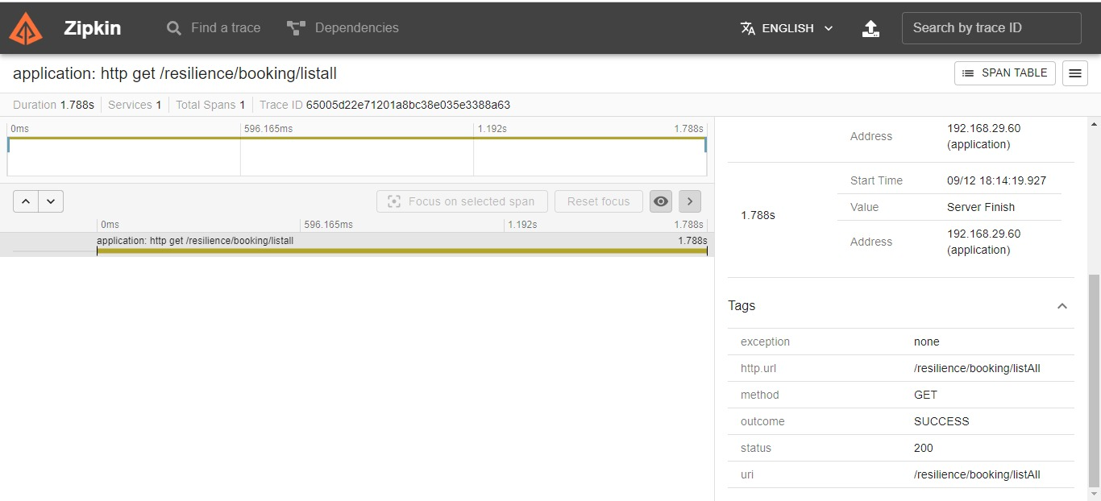

Slide 64
FEATURES
Automation of the entire process
Efficiency
Time Saving
Check ticket availability, bus timings and ticket price online
View boarding and dropping point
Access to payment

Slide 65
ADVANTAGES
User Friendly Interface
Reduced Expenses
Enhanced Customer Experience

Slide 66
CONCLUSION
The Online Bus Booking System that we developed, provides passengers an effective method to book their bus tickets, from the luxury of their homes.
This hassle free approach enhances customer satisfaction.
Tickets can be booked from any corner of the globe, which makes our ticket booking process highly flexible.
Custom seat selection allows passengers to choose the location of their seats based on their preference.
The Online Bus Booking System leads to reduction in manual labour which results in reduction in costs.

Slide 67

THANK YOU

